Slide 1
Digital Portfolio
STUDENT NAME: MITHRA B
REGISTER NO AND NMID: 2428c0095 7A14A7311B53ADA8E954CCEC12A27DF4
DEPARTMENT: BSC AIML
COLLEGE: COLLEGE/ UNIVERSITY:Sri Krishna Adithya college of arts and science Bharathiyar University

Slide 2
PROJECT TITLE My portfolio

Slide 3


AGENDA
Problem Statement
Project Overview
End Users
Tools and Technologies
Portfolio design and Layout
Features and Functionality
Results and Screenshots
Conclusion
Github Link
3/21/2024 Annual Review

Slide 4

PROBLEM STATEMENT
In today’s digital world, first impressions are often made online. Traditional resumes and offline introductions limit the ability to showcase creativity, technical skills, and projects effectively. There is a need for a digital portfolio that presents my skills, achievements, and projects in an engaging, professional, and accessible format.This portfolio aims to solve the problem of limited visibility and communication of personal capabilities by providing a structured, interactive, and visually appealing platform where potential employers, clients, or collaborators can easily explore my work and connect with me.

Slide 5

PROJECT OVERVIEW
Digital Portfolio
The Digital Portfolio is a personal website designed to showcase my skills, projects, and achievements in a professional and visually engaging way. Unlike traditional resumes, this portfolio provides an interactive platform where visitors can easily learn about me, view my work, and connect with me.The portfolio consists of the following sections:
Home – A welcoming introduction with my name, a short tagline, and navigation to other sections.About Me – A brief overview of my background, profile photo, and a summary of my skills and interests.
Projects – A dedicated space to highlight my key projects with descriptions and links to live demos or code repositories.
Contact – Contact details including email, phone number, and social media links for easy communication.

Slide 6

WHO ARE THE END USERS?
Recruiters / Hiring Managers
To evaluate my skills, projects, and achievements before offering job opportunities.
2. College Faculty / EvaluatorsTo review my portfolio as part of academic submissions or project assessments.
3. Clients (if you take freelance work)To explore my previous work and decide whether to collaborate.
4. Peers & CollaboratorsTo connect with me for team projects, hackathons, or research work.
5. General Audience / VisitorsAnyone interested in knowing about my skills, interests, and achievements.

Slide 7

TOOLS AND TECHNIQUES
HTML5 – For structuring the content and layout of the portfolio website.
CSS3 – For styling, responsive design, and creating a visually appealing interface.
JavaScript – For adding interactivity, smooth navigation, and dynamic features.
. CodePen / VS Code – As the development environment for writing and testing code.
Responsive Design Techniques – Ensuring the portfolio works seamlessly on desktops, tablets, and mobile devices.
Version Control (Git/GitHub) – For maintaining code versions and hosting the portfolio online.
. Image Optimization Tools – To reduce file size and improve loading speed.

Slide 8
POTFOLIO DESIGN AND LAYOUT
The digital portfolio is designed with a clean, modern, and user-friendly layout to ensure easy navigation and readability. The design follows a section-wise structure, allowing visitors to smoothly move through different parts of the portfolio.
Header / Navigation Bar – Contains links to different sections (Home, About, Projects, Contact).
Home Section – A welcoming introduction with my name, a short tagline, and a call-to-action button like “View My Work.”
8

Slide 9
FEATURES AND FUNCTIONALITY
Responsive Design – Works seamlessly on desktops, tablets, and smartphones.
Interactive Navigation – Smooth scrolling and clickable menu links for easy movement between sections.
Profile Showcase – A dedicated section with photo, bio, and key skills.
Project Gallery – Displays projects in cards/boxes with descriptions, images, and links to demos or source code.
Contact Form / Details – Allows visitors to connect via email, phone number, or social media.
Downloadable Resume Option – Provides a quick way to access my resume in PDF format.
Modern UI/UX Design – Clean layout, consistent colors, and professional typography for a good user experience.8. Performance Optimization – Fast loading with optimized images and code.

Slide 10
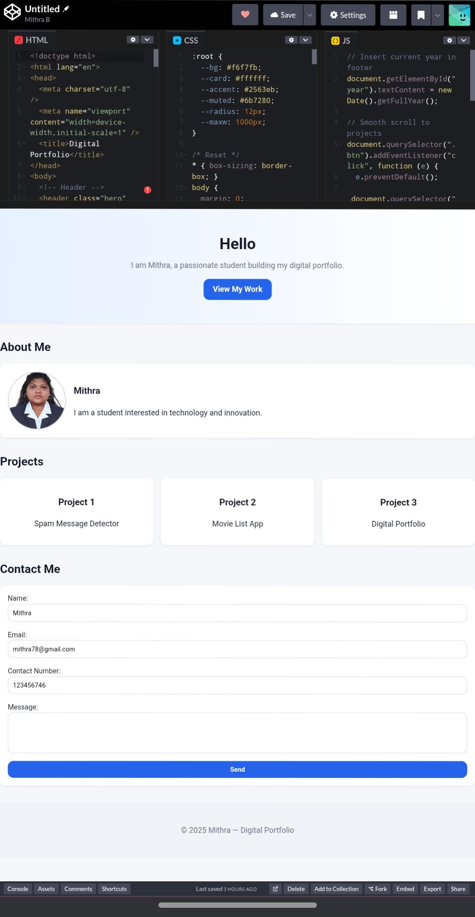

RESULTS AND SCREENSHOTS
The development of my Digital Portfolio successfully provided a professional platform to present my skills, projects, and achievements. The portfolio demonstrates
3/21/2024 Annual Review
10

Slide 11
CONCLUSION
The Digital Portfolio successfully provides a professional and interactive platform to showcase my skills, projects, and achievements. It overcomes the limitations of traditional resumes by offering an engaging, accessible, and responsive design that works across all devices. This project not only enhances my personal branding but also improves my chances of connecting with recruiters, clients, and collaborators.In conclusion, the portfolio has achieved its objective of creating a modern, user-friendly, and impactful representation of my work and abilities.
11

